Slide 1
Deep Learning For Rack Management Chen WuHeng
31th October 2019

Slide 2
Outline
System configuration
Phase-shift Full-bridge (FSFB) DC-DC converter operation
LLC DC-DC Converter operation
Comparison of PSFB and LLC

Slide 3
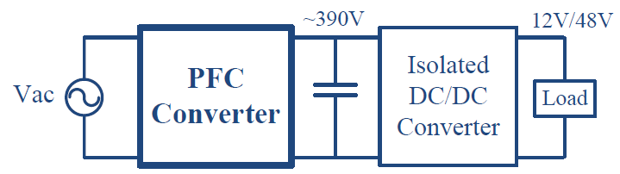
Power Architecture for Data Center Applications

Slide 4
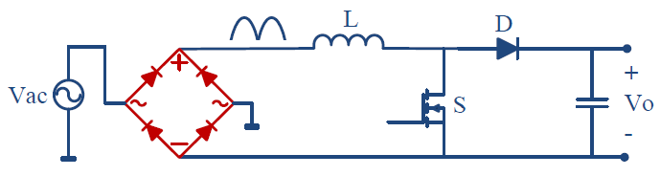
Boost PFC (Power Factor Corrector)

Slide 5
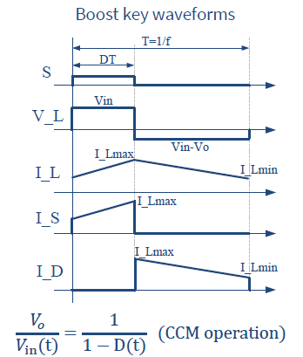
Boost Converter Key Waveforms

Slide 6

Power Losses in Boost Inductor in PFC
Inductor copper loss:
P_{L,conduction} ~ I²_{L,RMS} * R_{inductor,Total}
I_{L,RMS1} =P_{out}/V_{ac,HL} = 1400/240 = 5.83 A
I_{L,RMS2} =P_{out}/V_{ac,LL} = 1050/100 = 10.5 A
Inductor core losses

Slide 7
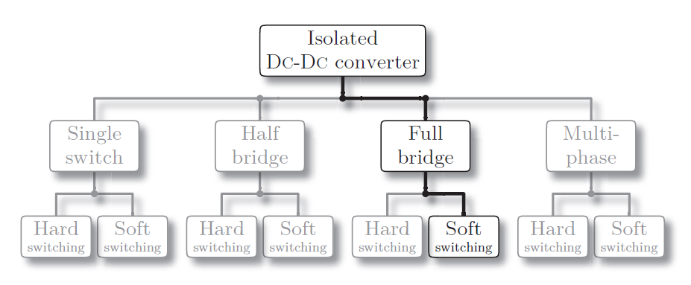
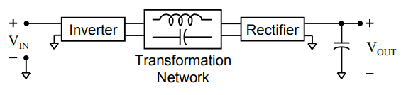
Conventional DC-DC Resonant Converter

Slide 8

DC-DC Converter Specifications
Parameter | Value
Input voltage | 380-400 V
Output voltage | 12 V
Max. Output current | 86.07 A (for 100-120 V AC input) 114.75 A (for 200-240 V AC input)
Target Efficiency | ≥ 90% @ P_{out} = 1400 W (80 PLUS Platinum) ≥ 94% @ P_{out} = 700 W (80 PLUS Platinum) ≥ 92% @ P_{out} = 280 W (80 PLUS Platinum) ≥ 94% @ P_{out} = 1400 W (80 PLUS Titanium) ≥ 96% @ P_{out} = 700 W (80 PLUS Titanium)
Switching frequency | 200 kHz ?

Slide 9
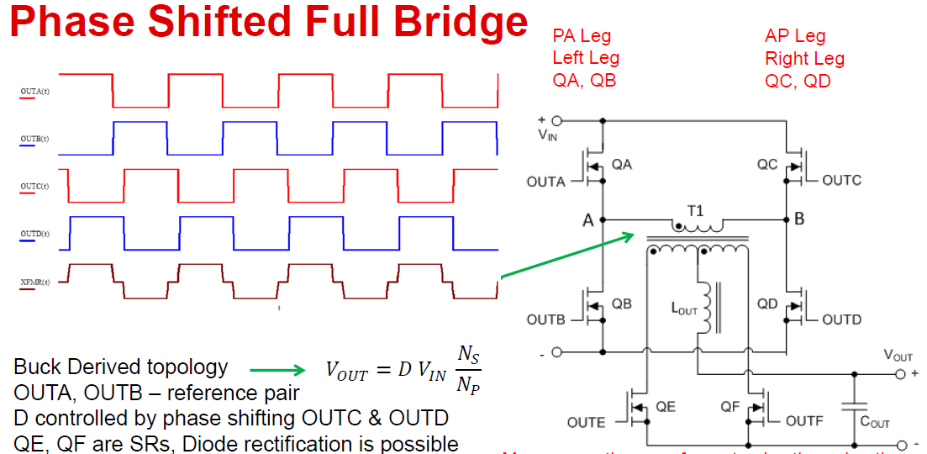
Phase Shifted Full Bridge (PSFB) Converter

Slide 10
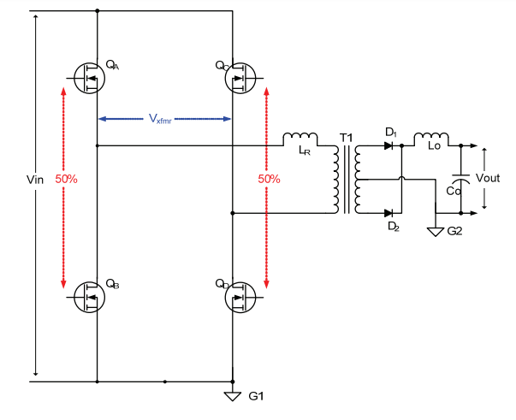
PSFB Circuit

Slide 11
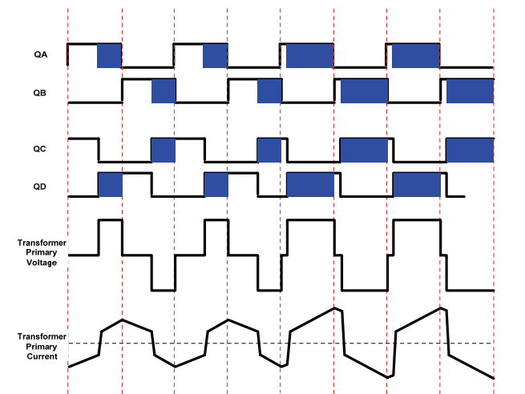
PSFB Circuit Operation

Slide 12
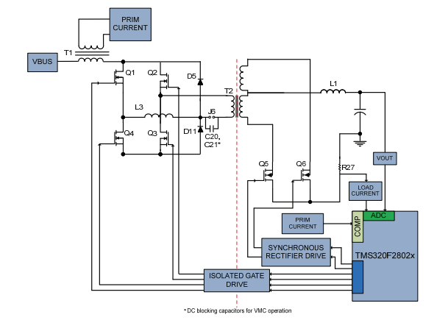
Voltage Mode Controlled PSFB

Slide 13
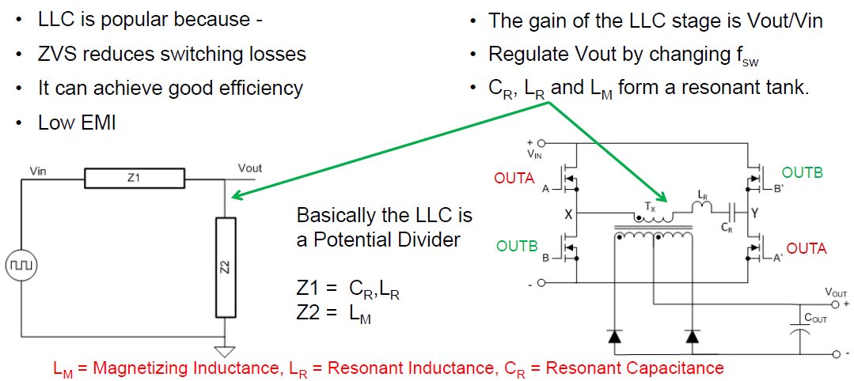
Full-bridge LLC Converter

Slide 14
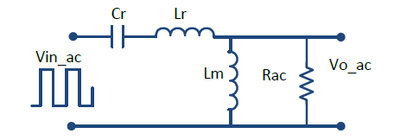
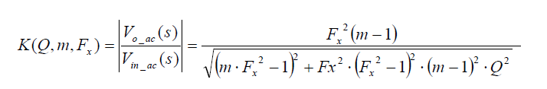
LLC Gain

Slide 15
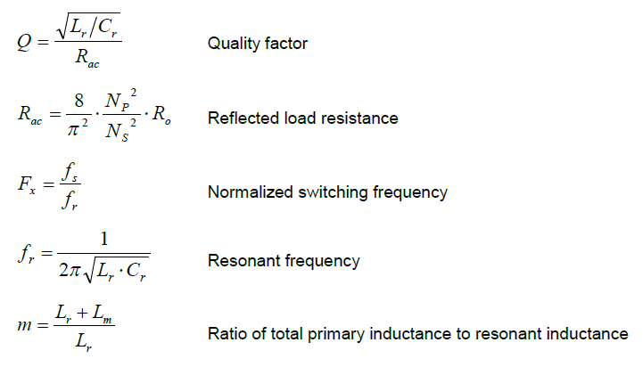

Slide 16
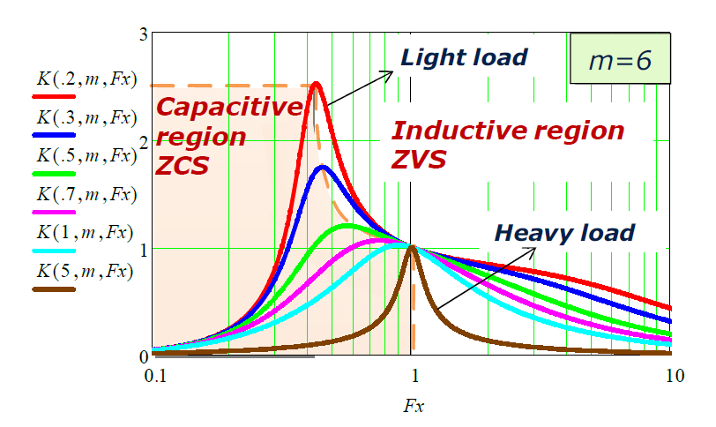
LLC Gain Curves

Slide 17
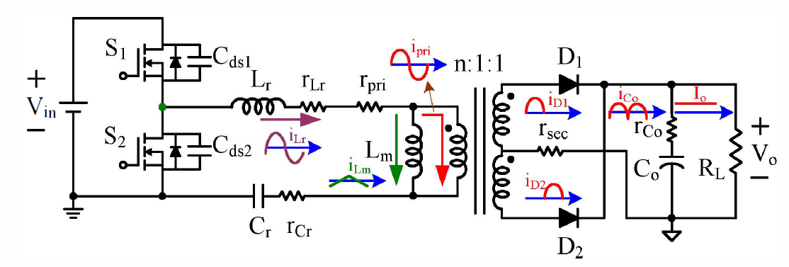
Half-Bridge LLC

Slide 18
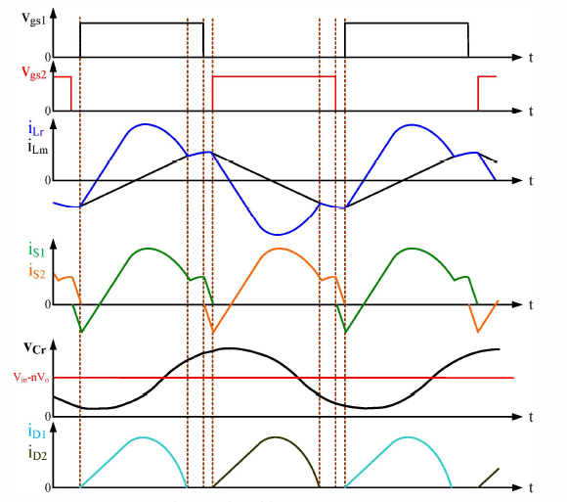
Half-bridge LLC waveforms

Slide 19
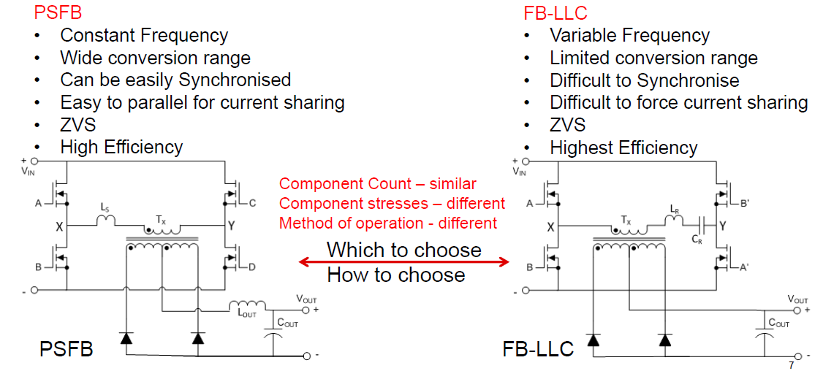
LLC vs PSFB DC-DC Converters

Slide 20
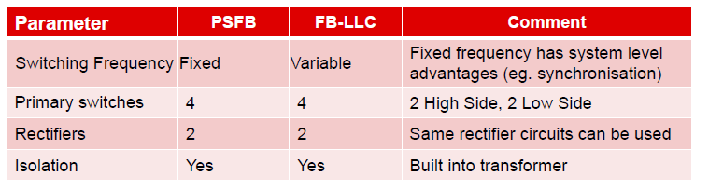
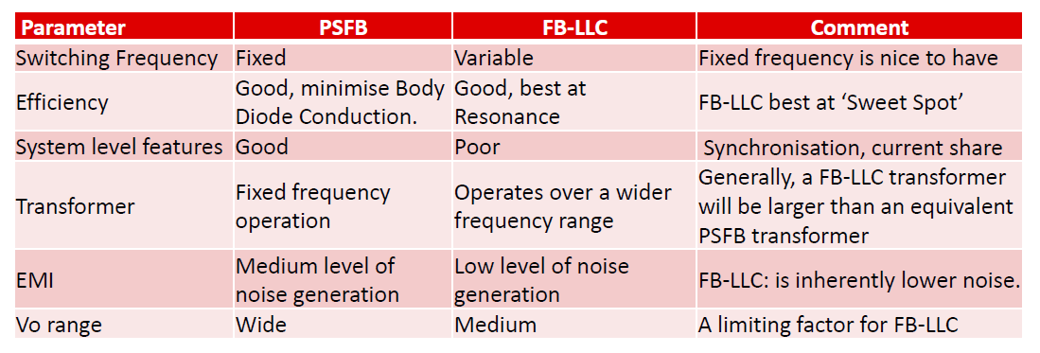
LLC and PSFB Comparison

Slide 21
Thank You Q & A

